Slide 1

Department of Computer Engineering
A Seminar Presentation on Topic Name: Brain-Computer Interfaces (BCI) – Neural links for direct communication.
Guided by:
Prof.Jayashri Waman
Presented by
Name : Kartik Jadhav
Roll No : 04
11 September 2025
1

Slide 2
Agenda
Introduction
Literature Survey
Problem Statement
Objectives
Motivation
System Architecture
Methodology
Pros & Cons
Application
Conclusion & Future Scope
References

Slide 3
Introduction
A Brain–Computer Interface (BCI) is an advanced communication system that enables direct interaction between the human brain and external devices without the need for traditional physical movements. By capturing and interpreting brain signals, BCIs allow individuals to control computers, prosthetics, or other machines simply through thought. This technology has gained significant importance in healthcare, assisting people with disabilities in regaining mobility and communication, while also opening new possibilities in fields like neuroscience, artificial intelligence, and human–machine interaction. As a rapidly evolving domain, BCIs represent a bridge between human cognition and digital innovation, bringing us closer to a future where mind and machine work seamlessly together.

Slide 4
Literature Survey
Sr. No | Paper and Author’s Name | Publication & year | Description | Challenges
1. | J.R. Wolpaw, N. Birbaumer, D.McFarland, G.Pfurtscheller, T.Vaughan | 2002 | Introduced the concept of BCI as a direct communication pathway between the brain and external devices, enabling control without muscle activity. | Low information transfer rate, requires extensive training.
2. | L.F.Nicolas-Alonso, J.Gomez-Gil | 2012 | Provided a comprehensive survey on a BCI technologies, highlighting applications in medical rehabilitation and assistive communication. | Signal noise, low accuracy , high dependency on EEG devices.
3 | R. Chatterjee, T. Bandyopadhyay | 2016 | Proposed EEG – based BCI systems for motor imagery, focusing on real-time control of prosthetic devices. | High processing time, difficulty in distinguishing complex brain signals.
11 September 2025
4

Slide 5
Problem Statement
Despite rapid advancements in computing and communication technologies, individuals with severe physical disabilities still face significant barriers in interacting with machines and expressing themselves effectively. Traditional input methods such as keyboards, touchscreens, or voice commands are often inaccessible to them. Brain–Computer Interfaces (BCIs) aim to bridge this gap by enabling direct communication between the human brain and external devices. However, current BCI systems still suffer from challenges such as low signal accuracy, slow information transfer rates, and high dependence on costly EEG hardware, which limit their widespread adoption and practical use.

Slide 6
Objectives
To analyze existing BCI technologies and their applications in healthcare and communication.
To study challenges such as low accuracy, signal noise, and high hardware costs.
To explore potential improvements for making BCI more reliable and accessible.
To introduce the concept and working of Brain–Computer Interfaces (BCIs).

Slide 7
Motivation
Helping individuals with severe physical disabilities regain communication and mobility.
Reducing dependency on traditional input devices (keyboard, mouse, touch, voice).
Supporting rehabilitation for patients with spinal cord injuries, stroke, or ALS.
Advancing prosthetic control using brain signals for natural movement.
Exploring applications in medicine, gaming, defense, and AI-driven systems.
Enabling hands-free interaction in hazardous or restricted environments.
Bridging the gap between human cognition and machine intelligence.
Inspiring future innovations towards human–machine symbiosis.

Slide 8
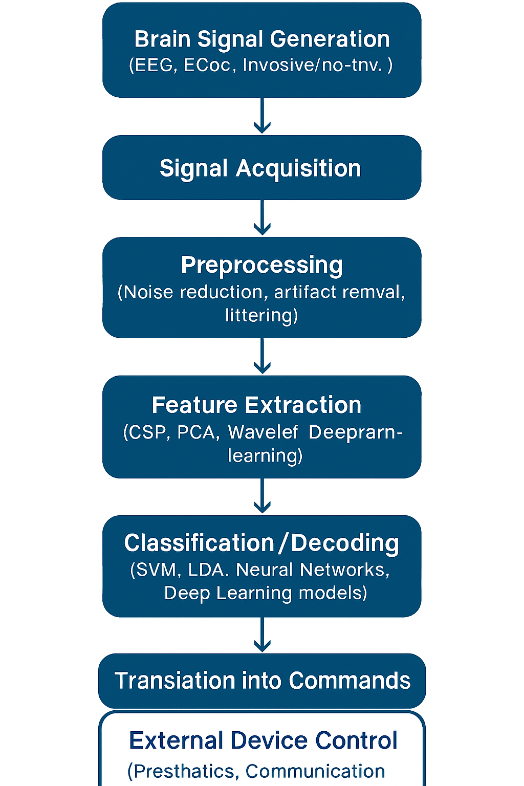
System Architecture

Slide 9
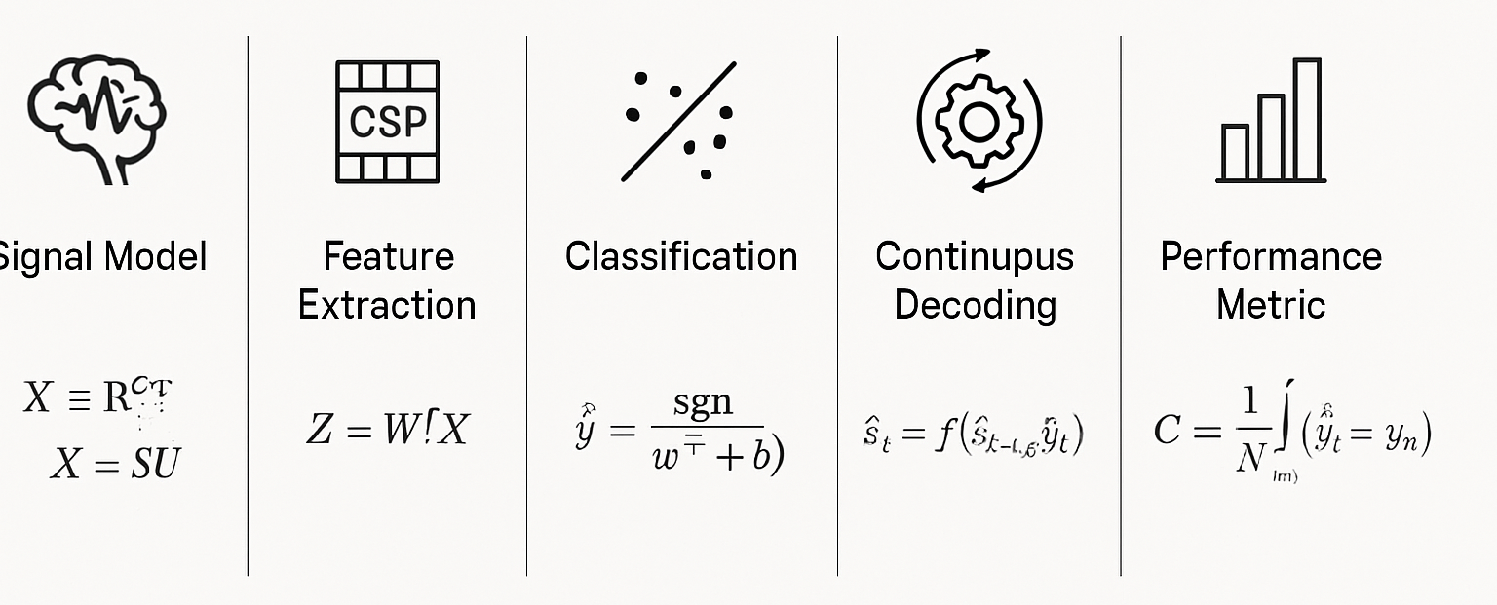
Mathematical Model

Slide 10
Methodology
Step 1: Record brain signals using EEG electrodes.
Step 2: Apply preprocessing to remove artifacts.
Step 3: Extract features (frequency, amplitude, wave patterns).
Step 4: Use machine learning for classification.
Step 5: Translate classified signals into control commands.
Step 6: Output device responds (cursor movement, prosthetic action)

Slide 11
Pros and Cons
Pros | Cons
Assists people with severe disabilities. | 1. Low signal accuracy and speed
2. Enables hands-free communication and control. | 2. High cost of devices and setup.
3. Wide applications (healthcare, robotics, gaming, defense) | 3. Requires training and calibration.
4. Advances human–machine interaction research | 4. Susceptible to noise and environmental interference.

Slide 12
Application
Medical rehabilitation (stroke, spinal cord injury, ALS).
Assistive technologies (prosthetics, communication aids).
Smart wheelchairs and robotic arm control.
Gaming and virtual reality.
Military and defense applications.
Brain-controlled smart home systems.

Slide 13
Conclusion & Future Scope
In conclusion, Brain–Computer Interfaces represent a breakthrough technology connecting the human brain with external devices. While they have shown remarkable potential in improving lives, particularly for people with disabilities, challenges like low accuracy, cost, and complexity remain. Ongoing research continues to make BCIs more efficient, reliable, and accessible.
Development of non-invasive, high-accuracy BCIs.
Integration with Artificial Intelligence for smarter decisions.
Affordable and portable BCI devices for mass adoption.
Applications in education, entertainment, and industry.
Towards human–AI symbiosis and neuro-enhancement.

